Slide 1
Training-Pose
Eti Reznikov
Yaara Goldenberg

Slide 2
Pose Estimation
There are many pose estimation methods, we will focus on the most relevant methods for our project:
Open-Pose
SMPL
HMR

Slide 3
Open-Pose- Realtime Multi-Person 2D Pose Estimation using Part Affinity Fields
OpenPose can provide real-time 2D pose estimation using a nonparametric representation to learn the body parts in an image dataset.
The method takes the entire image as the input for a CNN to jointly predict confidence map for body part detection and PAFs (Part Affinity Fields) for part association. The parsing step performs a set of bipartite matchings to associate body part candidates. Finally assemble them into full body poses for all people in the image.

Slide 4
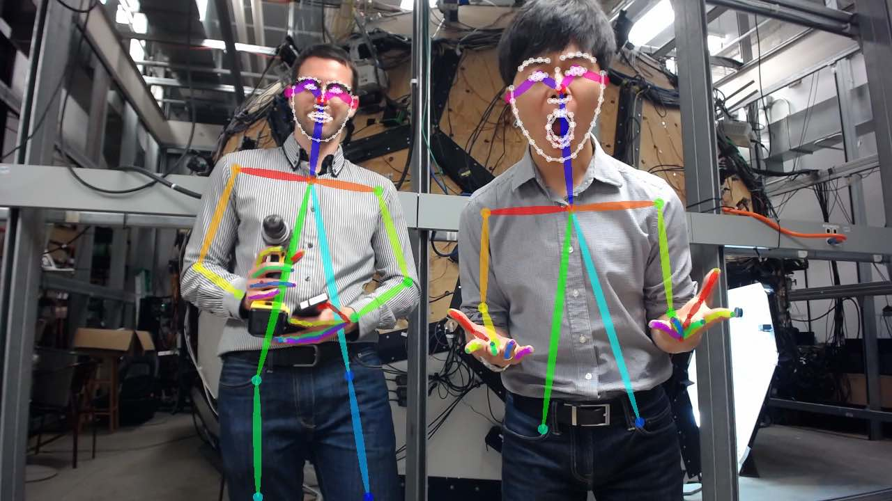
First, a feedforward network predicts a set of 2D confidence maps of body part locations and a set of 2D vector fields of part affinity fields (PAFs), which encode the degree of association between parts.
Then the confidence maps and the PAFs are parsed by greedy inference to output the 2D key points for all people in the image.
Given a set of detected body parts, the model needs to assemble them to form the full-body poses of an unknown number of people.

Slide 5
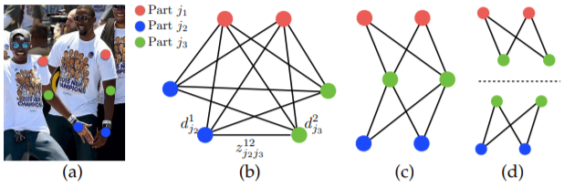
The greedy method
First, they choose a minimal number of edges to obtain a spanning tree skeleton of human pose rather than using the complete graph.
Second, they further decompose the matching problem into a set of bipartite matching sub problems and determine the matching in adjacent tree nodes independently. They show detailed comparison results, which demonstrate that minimal greedy inference well-approximates the global solution at a fraction of the computational cost.

Slide 6
SMPL- A Skinned Multi-Person Linear Model
The Skinned Multi-Person Linear model (SMPL) is a skinned vertex based model that accurately represents a wide variety of body shapes in natural human poses.
The parameters of the model are learned from data including the rest pose template, blend weights, pose-dependent blend shapes, identity-dependent blend shapes, and a regressor from vertices to joint locations.
The goal is to automatically learn a model of the body that is both realistic and compatible with existing graphics software.
The “Skinned Multi-Person Linear” (SMPL) model of the human body can realistically represent a wide range of human body shapes, can be posed with natural pose dependent deformations, exhibits soft-tissue dynamics, is efficient to animate, and is compatible with existing rendering engines.

Slide 7
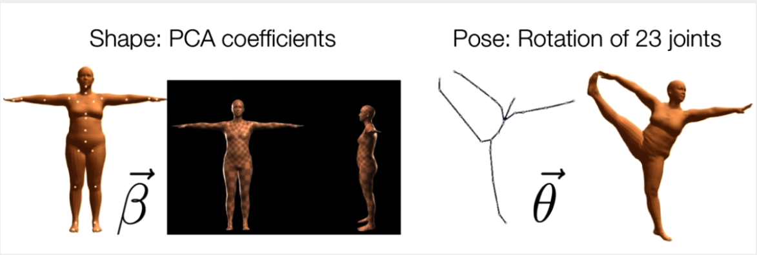
The SMPL is a statistical model that encodes the human subjects with two types of parameters:
Shape parameter: a shape vector of 10 scalar values, each of which could be interpreted as an amount of expansion/shrink of a human subject along some direction such as taller or shorter.
Pose parameter: a pose vector of 24x3 scalar values that keeps the relative rotations of joints with respective to their parameters. Each rotation is encoded as a arbitrary 3D vector in axis-angle rotation representation.

Slide 8
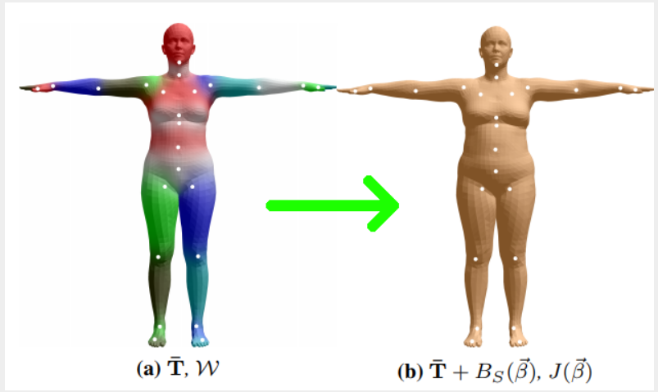
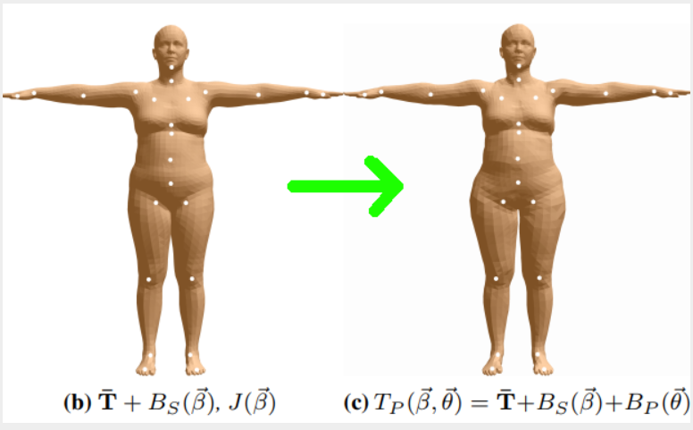
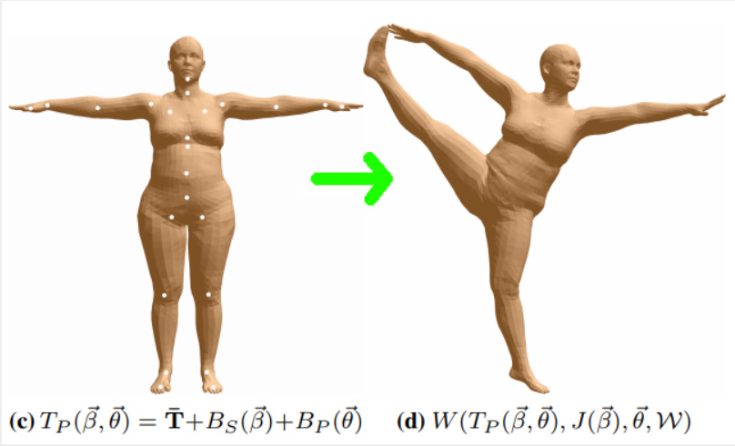

Shape Blend Shapes: In this step, a template(or mean) mesh $\overline{T}$ is added with vertex displacements that represent how far the subject shape is from the mean shape.
Pose Blend Shapes: After the identity mesh is constructed in the rest pose, it is further added with vertex displacements that explain for deformation correction caused by a specific pose. In other words, the pose in the next step “Skinning” results in some amount of deformation on the rest pose at this step.
Skinning: Each mesh vertex from the previous step is transformed by a weighted-combination of joint deformation. To put it simply, the closer to a vertex a joint is, the stronger the joint rotates/transforms the vertex.

Slide 9
HMR-
HMR- an end-to-end framework for reconstructing a full 3D mesh of a human body from a single RGB image, use the generative human body model, SMPL, which parameterizes the mesh by 3D joint angles and a low dimensional linear shape space. Estimating a 3D mesh opens the door to a wide range of applications such as foreground and part segmentation, which is beyond what is practical with a simple skeleton. The output mesh can be immediately used by animators, modified, measured, manipulated and retargeted. The output is also holistic – it’s always infer the full 3D body even in cases of occlusion and truncation.
There are several challenges, however, in training such a model in an end-to-end manner. First is the lack of largescale ground truth 3D annotation for in-the-wild images.
Existing datasets with accurate 3D annotations are captured in constrained environments. Models trained on these datasets do not generalize well to the richness of images in the real world.
Another challenge is in the inherent ambiguities in single-view 2D-to-3D mapping. Most well known is the problem of depth ambiguity where multiple 3D body configurations explain the same 2D projections.

Slide 10
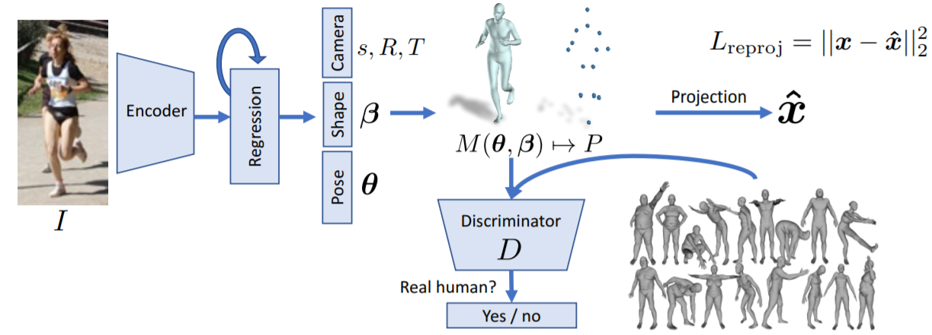
Overview of the proposed framework- an image is passed through a convolutional encoder, this is sent to an iterative 3D regression module that infers the latent 3D representation of the human that minimizes the joint re-projection error, the 3D parameters are also sent to the discriminator, whose goal is to tell if these parameters come from a real human shape and pose.

Slide 11
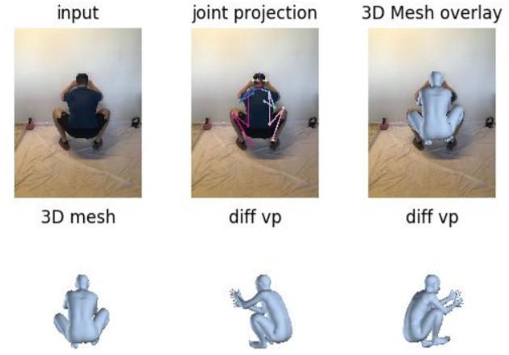
The model go beyond the existing techniques in multiple ways:
1. It’s infer 3D mesh parameters directly from image features, while previous approaches infer them from 2D key points. This avoids the need for two stage training and also avoids throwing away valuable information in the image such as context.
2. Going beyond skeletons, the output meshes, which are more complex and more appropriate for many applications. Again, no additional inference step is needed.
3.The framework is trained in an end-to-end manner. The auteurs out-perform previous approaches that output 3D meshes in terms of 3D joint error and run time.
4. The auteurs show results with and without paired 2D-to-3D data. Even without using any paired 2D-to-3D supervision, their approach produces reasonable 3D reconstructions.

Slide 12
Relevant research
Visual Feedback
Everybody Dance Now

Slide 13
Visual Feedback
A visual feedback system for core training using a monocular camera image. To support the user in maintaining the correct postures from target poses, by adopting 3D human shape estimation for both the target image and input camera video.
Its aim to provide a user interface for visual feedback in sports training using state of-the-art pose estimation approaches. In contrast to 3D sensing using laser sensors or depth cameras, the proposed system only requires a single image from a standard web camera.
The framework consists of two main components: pose estimation and visual feedback.
To obtain 3D human shape and pose from a single image, the proposed system adopts pose estimation based on OpenPose to realize the bounding box of the human region. It also employs human mesh recovery to estimate the 3D human pose. For the generation of 3D human mesh, an SMPL model is used.

Slide 14
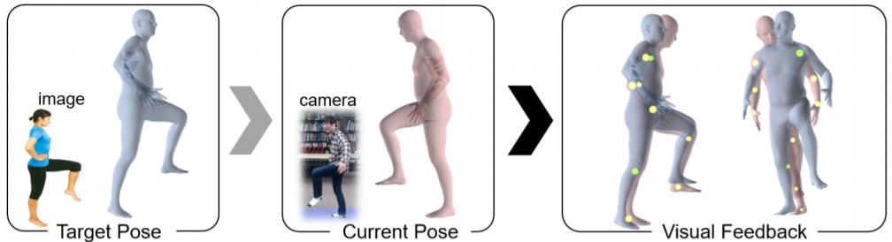
For visual feedback, a runtime user interface is proposed to guide the user on the differences between target pose and the current pose from the captured frame. Both target and current poses are estimated from a single image using the pose estimation method discussed above.
For representing the differences between target and current 3D models, they adopt color visualization on predefined 10 marker positions on the human body. They set the marker positions at both hands and elbows, shoulders, knees, and ankles because the differences of the two models are more apparent at the end parts than the human trunk. They did not choose hip joints on the body because the differences in hip points are not apparent due to coincided waist positions.
They used shoulders, elbows, and hands positions for a good representation of the upper body postures, which are the most important parts in core training

Slide 15
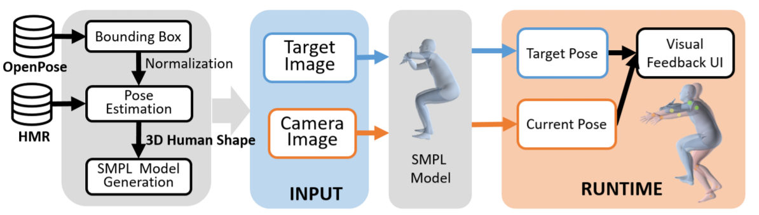
To obtain the marker positions using SMPL-based human model, they superimposed the aforementioned joint positions with SMPL mesh model to determine the start and end points for each marker.
To obtain the mesh vertices of markers, they substituted the transformation matrix of perspective projection from the 3D model to the output image.
The current execution time of the proposed visual feedback system is about 2 seconds for one frame. Although it may be suitable for core training because the user has to maintain the pose over a long period, it will be bottle-neck for other sports such as gymnastics and ball sports where movement is in high speed.

Slide 16
Everybody Dance Now
This paper presents a simple method for “do as I do” motion transfer: Given two videos – one of a target person whose appearance we wish to synthesize, and the other of a source subject whose motion we wish to impose onto our target person – we transfer motion between these subjects by learning a simple video-to-video translation.
Although their method is quite simple, it produces surprisingly compelling results.
To transfer motion between two video subjects in a frame-by-frame manner, they must learn a mapping between images of the two individuals. Their goal is, therefore, to discover an image-to-image translation between the source and target sets.
However, they do not have corresponding pairs of images of the two subjects performing the same motions to supervise learning this translation. Even if both subjects perform the same routine, it is still unlikely to have an exact frame to frame pose correspondence due to body shape and motion style unique to each subject.

Slide 17
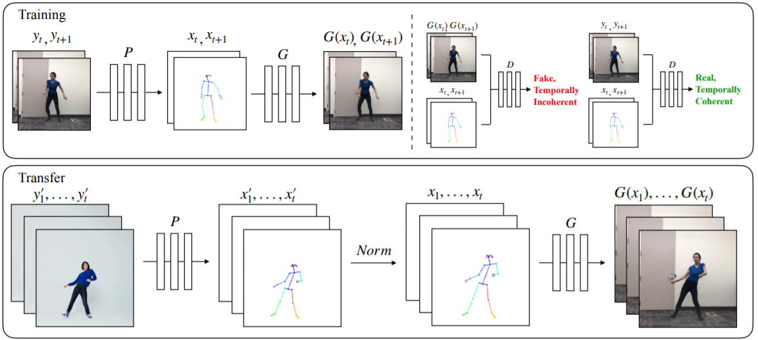
They observe that key point based pose preserves motion signatures over time while abstracting away as much subject identity as possible and can serve as an intermediate representation between any two subjects.
To accomplish this task, they divide their pipeline into three stages – pose detection, global pose normalization, and mapping from normalized pose stick figures to the target subject.

Slide 18
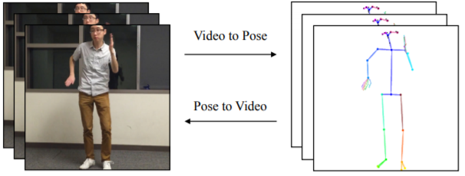
Encoding body poses
To encode the body pose of a subject image, they use a pre-trained pose detector which accurately estimates 2D x, y joint coordinates. Then they create a colored pose stick figure by plotting the key points and drawing lines between connected joints as shown in the figure.
Global pose normalization
In different videos, subjects may have different limb proportions or stand closer or farther to the camera than one another. Therefore when retargeting motion between two subjects, it may be necessary to transform the pose key points of the source person so that they appear in accordance with the target person’s body shape and location.

Slide 19
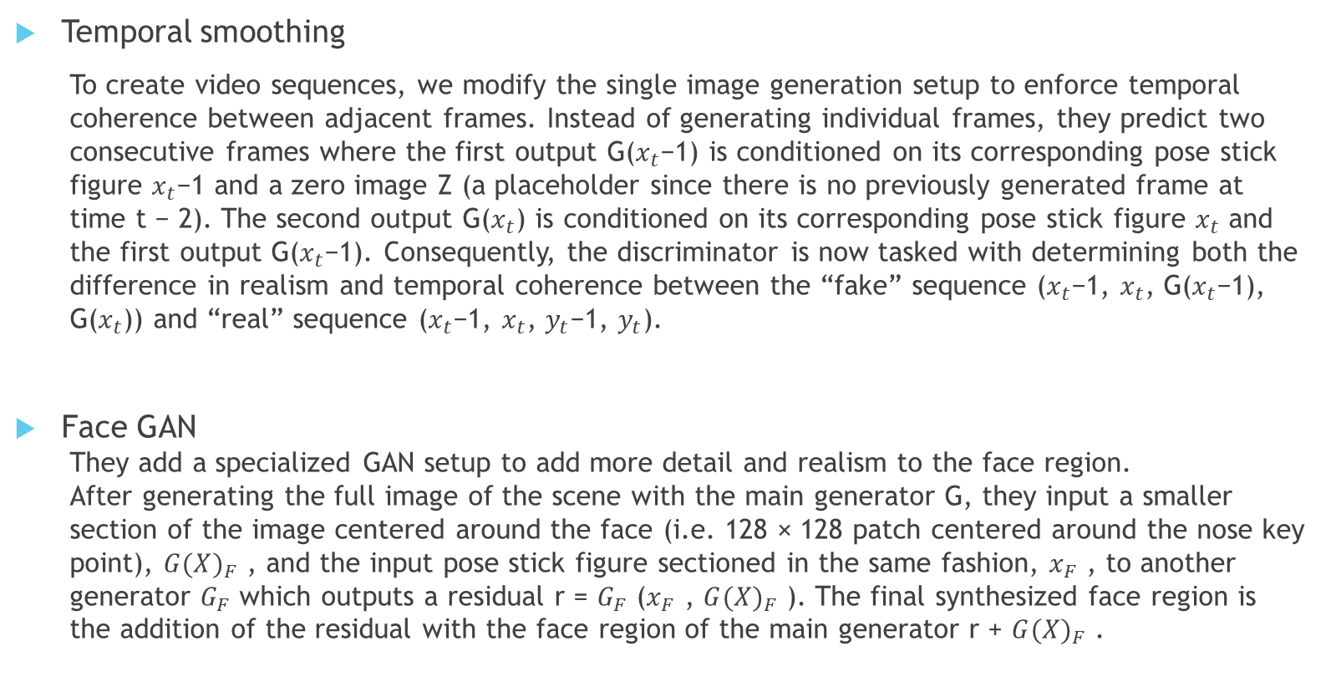
Temporal smoothing
To create video sequences, we modify the single image generation setup to enforce temporal coherence between adjacent frames. Instead of generating individual frames, they predict two consecutive frames where the first output G($x_{t}$−1) is conditioned on its corresponding pose stick figure $x_{t}$−1 and a zero image Z (a placeholder since there is no previously generated frame at time t − 2). The second output G($x_{t}$) is conditioned on its corresponding pose stick figure $x_{t}$ and the first output G($x_{t}$−1). Consequently, the discriminator is now tasked with determining both the difference in realism and temporal coherence between the “fake” sequence ($x_{t}$−1, $x_{t}$, G($x_{t}$−1), G($x_{t}$)) and “real” sequence ($x_{t}$−1, $x_{t}$, $y_{t}$−1, $y_{t}$).
Face GAN
They add a specialized GAN setup to add more detail and realism to the face region.
After generating the full image of the scene with the main generator G, they input a smaller section of the image centered around the face (i.e. 128 × 128 patch centered around the nose key point), ${G(X)}_{F}$ , and the input pose stick figure sectioned in the same fashion, $x_{F}$ , to another generator $G_{F}$ which outputs a residual r = $G_{F}$ ($x_{F}$ , ${G(X)}_{F}$ ). The final synthesized face region is the addition of the residual with the face region of the main generator r + ${G(X)}_{F}$ .

Slide 20
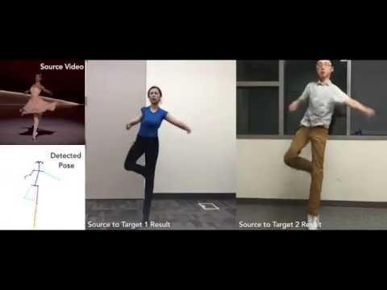
Everybody Dance Now- video

